Slide 1

Vivekanand Education Society’s Institute Of Technology
Master of Computer Applications
Project Review I
Title: ProctoEase – Smart Online Assessment & Proctoring Platform
Domain: Web Application Development • AI-Assisted Proctoring
• Online Examination System
Group Members:
Member1 : Rahul Bhagwat (03/A)
Member2 : Sudheer Prajapati (45/A)
Member3 : Rushikesh yadav (61/A)
Mentor Name: Indira B Mam

Slide 2
Content
Introduction to the project
Problem Statement
Objectives of the project
Requirements of the system (Hardware, software)
System Design
Front End
Implementation
Gantt Chart
Conclusion
References

Slide 3
Introduction to Project
ProctoEase is a web-based assessment and proctoring platform designed for recruiters, institutes, and training centers. It allows organizations to conduct MCQ tests, coding tests, and AI-assisted remote proctoring using browser technologies.
It ensures fairness, transparency, and security in online examinations by detecting cheating behaviors like face absence, tab switching, audio spikes, IP changes, and generating a Proctor Risk Score.
r Rates

Slide 4
Problem Statement
Existing assessment platforms like Mercer Mettl and Talview are:
Too expensive for small institutes
Complex to use and maintain
Not transparent with proctoring rules
Heavy on resource usage (continuous video recording)
Do not integrate coding execution + plagiarism detection in one platform
So, there is a need for a lightweight, affordable, transparent, and AI-assisted proctoring system.
r Rates

Slide 5
Objectives of the project
Primary Objectives
Conduct secure MCQ & coding tests
Implement browser-based AI proctoring
Log suspicious activities with snapshots
Generate explainable Proctor Risk Scores
Support multi-tenancy for multiple organizations
Secondary Objectives
Offline answer saving
JPlag/MinHash plagiarism detection
Judge0-based code execution
Recruiter dashboards and exportable reports
Audit logs & accessibility features
Rates

Slide 6
Requirements of the system (Hardware, software)
Software Requirements
Frontend: React + TypeScript
Backend: FastAPI, Python
Database: PostgreSQL
Proctoring: MediaPipe / face-api.js, WebRTC
Code Execution: Judge0
Plagiarism Tool: JPlag / MinHash
Others: Redis, Celery, S3/MinIO for storage
Hardware Requirements
Laptop/PC with webcam & microphone
Minimum 4GB RAM
Stable internet connection
lem Statement
Problem Statement

Slide 7
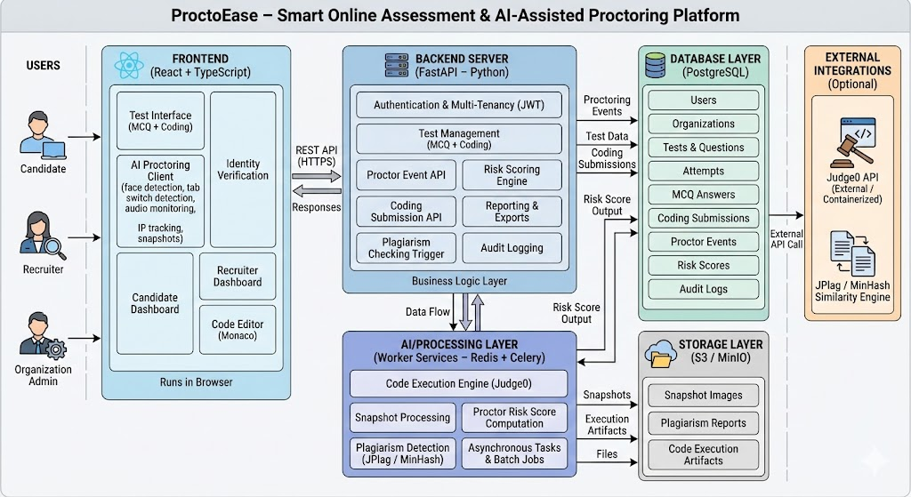
System Design of the proposed system

Slide 8
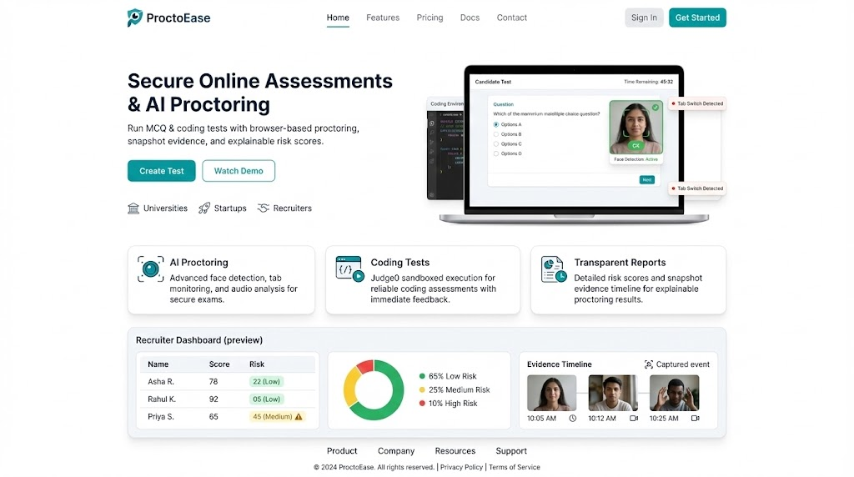
Front End
Home Page
Clean, modern landing page design
Highlights AI proctoring, coding tests, and transparent reports.
Displays candidate test preview (face detection, tab switch alerts).
Shows recruiter dashboard summary (risk score, analytics, evidence timeline).
Designed for responsive experience using React + TailwindCSS.

Slide 9
Implementation
Implementation – Frontend Module
Developed using React + TypeScript & TailwindCSS.
Home page designed as a real SaaS landing page.
Includes candidate preview panel and proctoring indicators.
Integrated Monaco editor & proctoring overlay.
Shows risk score card, evidence timeline, and dashboard preview.
Focus on UX clarity, accessibility, responsiveness.

Slide 10
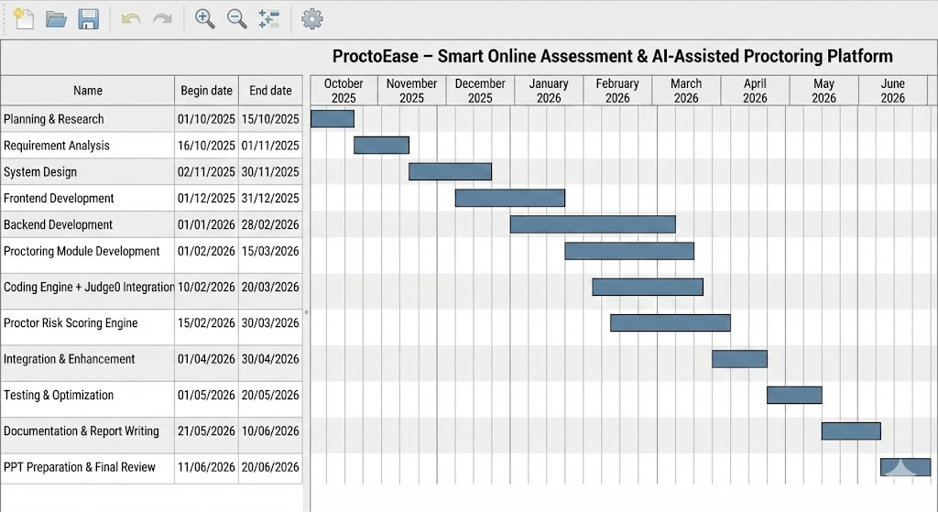
Gantt Chart
Notes:
The max flow algorithm in the visualization is :-

Slide 11
Conclusion
ProctoEase successfully delivers a secure, transparent, and AI-assisted online exam system with features like:
MCQ & coding assessments
Browser-based proctoring
Snapshot-based evidence
Proctor Risk Score
Multi-tenant architecture
Plagiarism detection
Reliable offline support
It acts as a lighter, cost-effective alternative to enterprise platforms while remaining highly practical for academic and real-world use.

Slide 12
References
Bawa, N. & Girdhar, A., “AI-Based Proctoring Techniques for Online Examinations,” IEEE Xplore, 2021.
Zhao, Y., et al., “Face Detection via Deep Learning for Remote Exam Monitoring,” Springer LNCS, 2020.
Kumar, P., “Online Examination System with Real-Time Proctoring,” IJCA, 2022.
Mercer Mettl, “Online Proctoring Market Trends Report,” 2022.
Google MediaPipe Documentation, 2023.
Judge0 API Documentation, 2023.
JPlag Official Documentation, 2023.
FastAPI Documentation, 2023.
NASSCOM Technology Adoption in Education Report, 2023.
Talview Whitepaper on AI Proctoring, 2023.

